Slide 1

https://ohis.org/
Open Headset Interconnect Standard
Mark Smith, N6MTS

Slide 2


https://ohis.org/
Who am I?
Mark Smith, N6MTS
President/CEO, Halibut Electronics: https://electronics.halibut.com/
A host of the Ham Radio Workbench Podcast:
https://www.hamradioworkbench.com/
YouTube: @SmittyHalibut
Mastodon/Fediverse: @smitty@halibut.com
Video

Slide 3
https://ohis.org/
Who am I?
Mark Smith, N6MTS
President/CEO, Halibut Electronics: https://electronics.halibut.com/
A host of the Ham Radio Workbench Podcast:
https://www.hamradioworkbench.com/
YouTube: @SmittyHalibut
Mastodon/Fediverse: @smitty@halibut.com
Head Cheese
Video

Slide 4
https://ohis.org/
Who am I?
Ham: Active ham since 1992.
College: Two years in Electrical Engineering, but degree in Computer Engineering, CalPoly San Luis Obispo
Work: ~30 years in IT, Network and Unix Systems Engineering, and Information Security.
All Three: Left IT in 2021, started Halibut Electronics to make Ham Radio and Audiophile electronics.
Video

Slide 5
https://ohis.org/
Open Headset Interconnect Standard
Video

Slide 6
https://ohis.org/
Open Headset Interconnect Standard
Open: Any individual or company may make devices compliant with this standard, with no obligation.
Video

Slide 7
https://ohis.org/
Open Headset Interconnect Standard
Open: Any individual or company may make devices compliant with this standard, with no obligation.
Headset: Describes the signaling commonly found between a user and a radio: Microphone, Headphones, and Push To Talk.
Video

Slide 8
https://ohis.org/
Open Headset Interconnect Standard
Open: Any individual or company may make devices compliant with this standard, with no obligation.
Headset: Describes the signaling commonly found between a user and a radio: Microphone, Headphones, and Push To Talk.
Interconnect: Describes both the physical and electrical connection of those signals between the user and radio.
Video

Slide 9
https://ohis.org/
Open Headset Interconnect Standard
Open: Any individual or company may make devices compliant with this standard, with no obligation.
Headset: Describes the signaling commonly found between a user and a radio: Microphone, Headphones, and Push To Talk.
Interconnect: Describes both the physical and electrical connection of those signals between the user and radio.
Standard: Devices built to this standard will work with other devices built to the same standard.
Video

Slide 10
https://ohis.org/
Electrical Standards
We have electrical standards (defined, or de-facto) for things like RF and Power:
Video

Slide 11
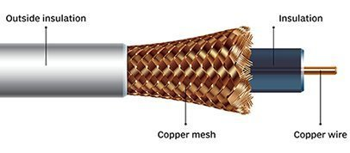
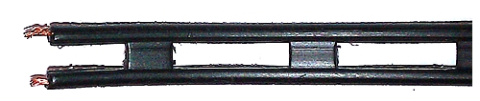
https://ohis.org/
Electrical Standards
We have electrical standards (defined, or de-facto) for things like RF and Power:
RF: 50 ohm impedance coax, 450 ohm twin lead
Video

Slide 12

https://ohis.org/
Electrical Standards
We have electrical standards (defined, or de-facto) for things like RF and Power:
RF: 50 ohm impedance coax, 450 ohm twin lead
Power: +13.8vDC +/- 15%
Video

Slide 13
https://ohis.org/
Physical Standards
And one, or a few, physical standards that are easy to convert between:
Video

Slide 14
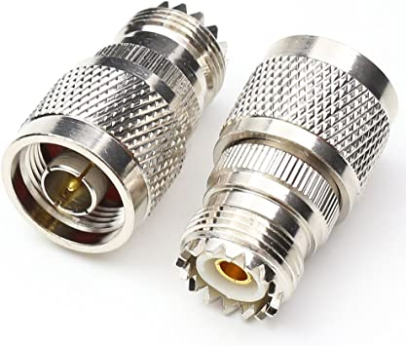
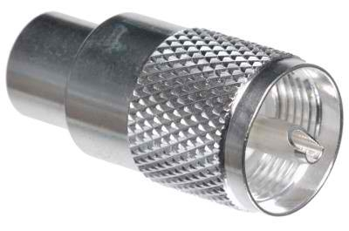
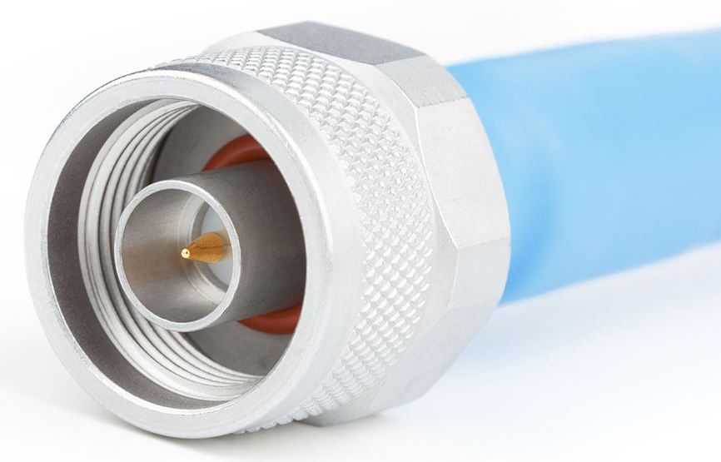
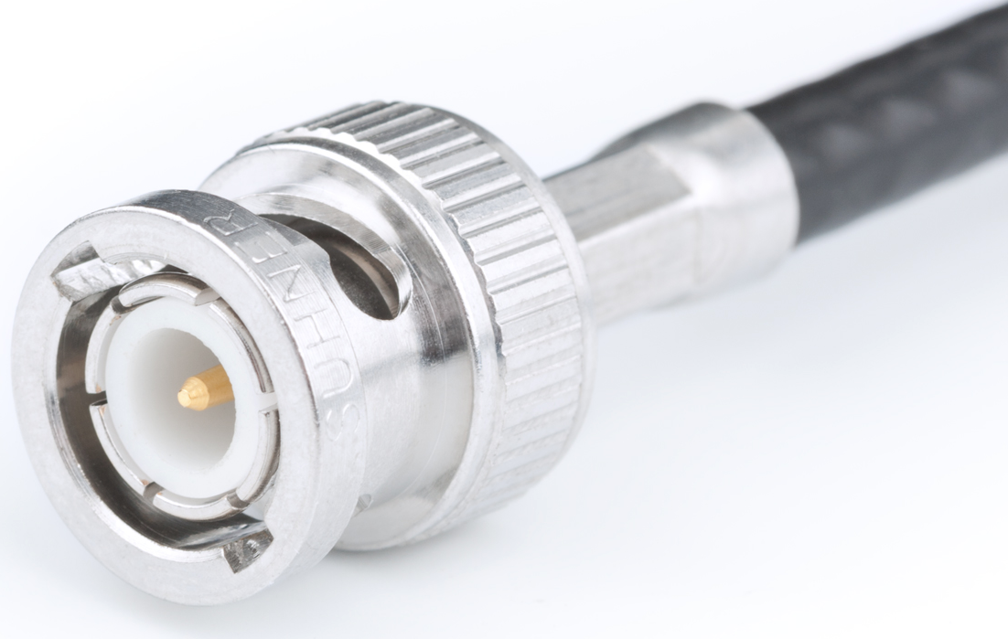
https://ohis.org/
Physical Standards
And one, or a few, physical standards that are easy to convert between:
RF: PL-259, Type N, BNC, etc
Video

Slide 15
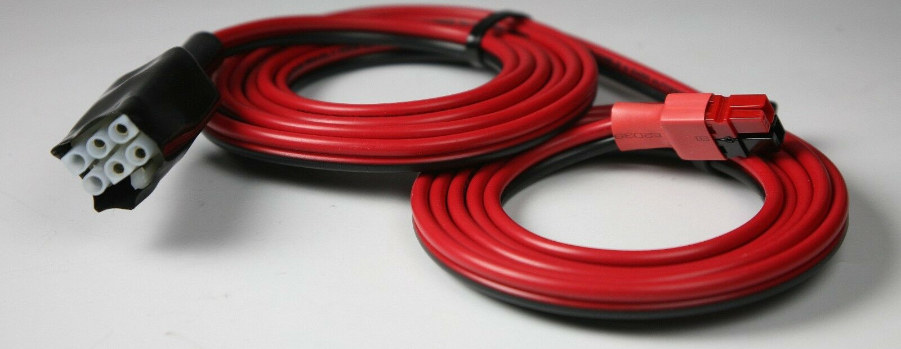
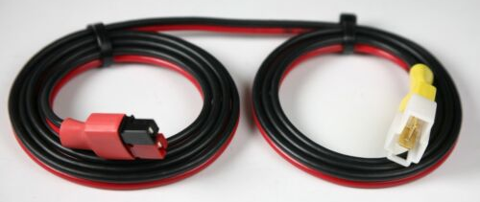
https://ohis.org/
Physical Standards
And one, or a few, physical standards that are easy to convert between:
RF: PL-259, Type N, BNC, etc
Power: Powerpole, 6-pin “Molex”, “T” blades, etc
Video

Slide 16
https://ohis.org/
Headset Standards?
No such electrical standards exist for the User to Radio interface:
Video

Slide 17
https://ohis.org/
Headset Standards?
No such electrical standards exist for the User to Radio interface:
Microphone: Dynamic, Electret, or Carbon? Balanced or single ended?
Video

Slide 18
https://ohis.org/
Headset Standards?
No such electrical standards exist for the User to Radio interface:
Microphone: Dynamic, Electret, or Carbon? Balanced or single ended?
Audio out: Line level, headphone level, or speaker level? Ground referenced or push-pull? Mono or stereo?
Video

Slide 19
https://ohis.org/
Headset Standards?
No such electrical standards exist for the User to Radio interface:
Microphone: Dynamic, Electret, or Carbon? Balanced or single ended?
Audio out: Line level, headphone level, or speaker level? Ground referenced or push-pull? Mono or stereo?
PTT: GPIO style contact closure to ground, or completing the mic circuit?
Video

Slide 20
https://ohis.org/
So many to choose from!
There are even more physical options to choose from!
Video

Slide 21
https://ohis.org/
So many to choose from!
There are even more physical options to choose from!
Microphone: 3.5mm TS/TRS? ¼” TS/TRS? XLR? “8-pin round” Aviation? 8 pin modular? 6 pin modular? What pinout?
Video

Slide 22
https://ohis.org/
So many to choose from!
There are even more physical options to choose from!
Microphone: 3.5mm TS/TRS? ¼” TS/TRS? XLR? “8-pin round” Aviation? 8 pin modular? 6 pin modular? What pinout?
Audio out: 3.5mm TS/TRS? ¼” TS/TRS? RCA?
Video

Slide 23
https://ohis.org/
So many to choose from!
There are even more physical options to choose from!
Microphone: 3.5mm TS/TRS? ¼” TS/TRS? XLR? “8-pin round” Aviation? 8 pin modular? 6 pin modular? What pinout?
Audio out: 3.5mm TS/TRS? ¼” TS/TRS? RCA?
PTT: On the mic connector? 3.5mm TS? ¼” TS?
Video

Slide 24
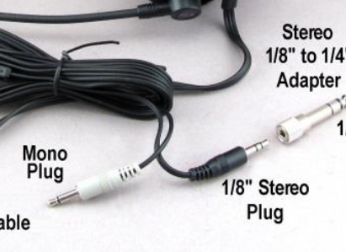
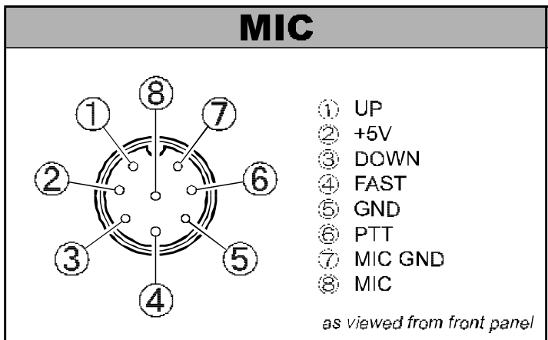
https://ohis.org/
The problem is...
Heil Pro 7 Headset:
Yaesu FT-920 Microphone pinout:
Video

Slide 25
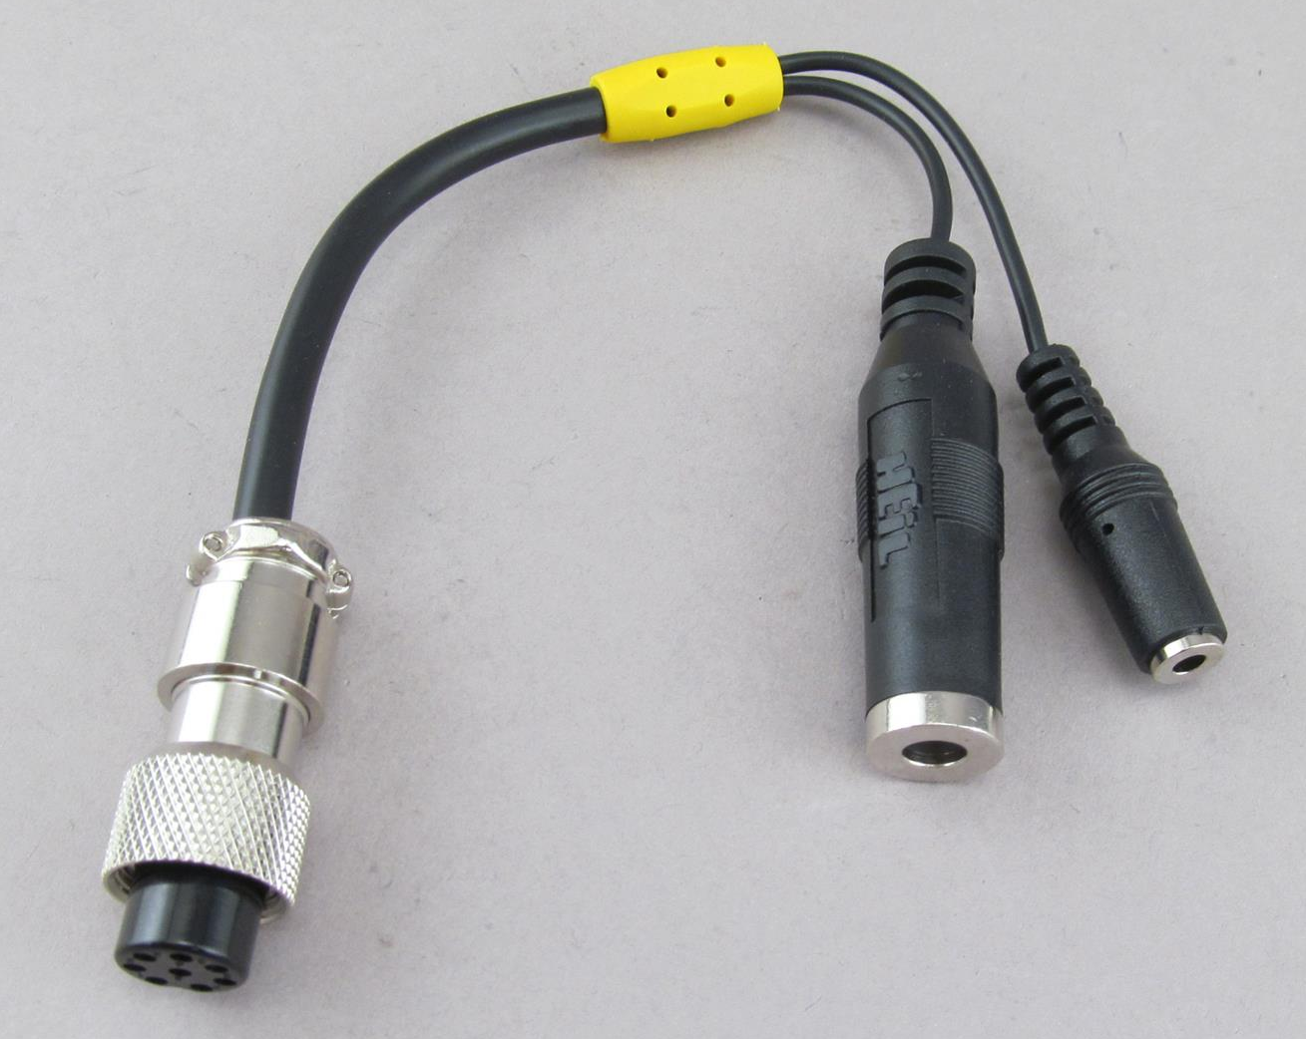
https://ohis.org/
The solution?
Heil AD-1-Y Adapter:
Yaesu FT-920 Microphone pinout:
Heil Pro 7 Headset:
Yaesu FT-920 Microphone pinout:
Video

Slide 26
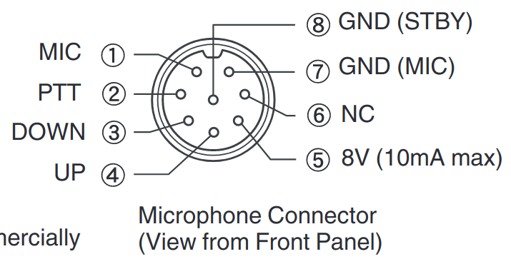
https://ohis.org/
But, I’ve got a Kenwood too.
Yaesu FT-920 Microphone pinout:
Kenwood TS-890S Microphone pinout:
Yaesu FT-920 Microphone pinout:
Kenwood TS-890S Microphone pinout:
Video

Slide 27
https://ohis.org/
But, I’ve got a Kenwood too.
Heil Pro 7 Headset:
Kenwood TS-890S Microphone pinout:
Video

Slide 28
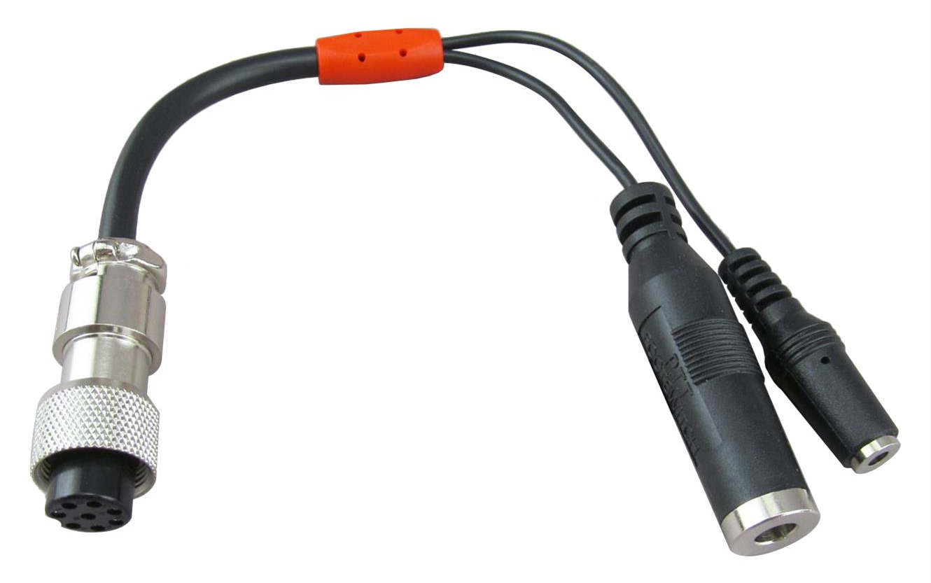
https://ohis.org/
Bob has me covered...
Heil AD-1-K Adapter:
Heil Pro 7 Headset:
Kenwood TS-890S Microphone pinout:
Video

Slide 29
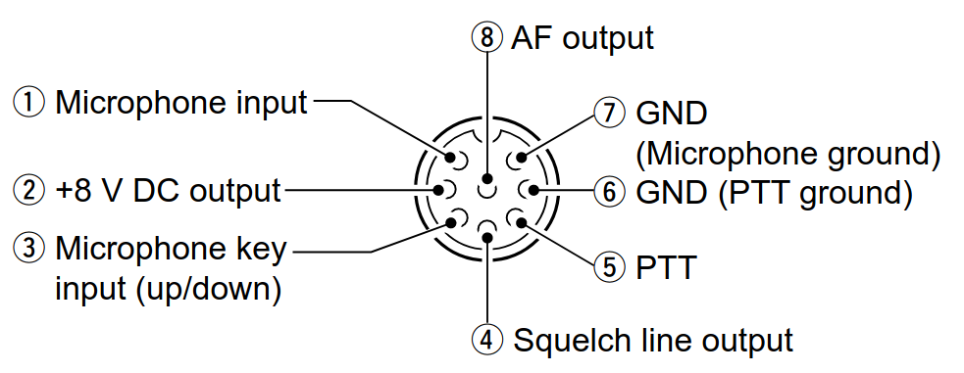
https://ohis.org/
What about Icom?
Heil Pro 7 Headset:
Icom IC-7300 Microphone pinout:
Video

Slide 30
https://ohis.org/
Same connect-- oh… Never mind...
Yaesu FT-920 Microphone pinout:
Icom IC-7300 Microphone pinout:
Kenwood TS-890S Microphone pinout:
Video

Slide 31
https://ohis.org/
What about Icom?
Heil Pro 7 Headset:
Icom IC-7300 Microphone pinout:
Video

Slide 32
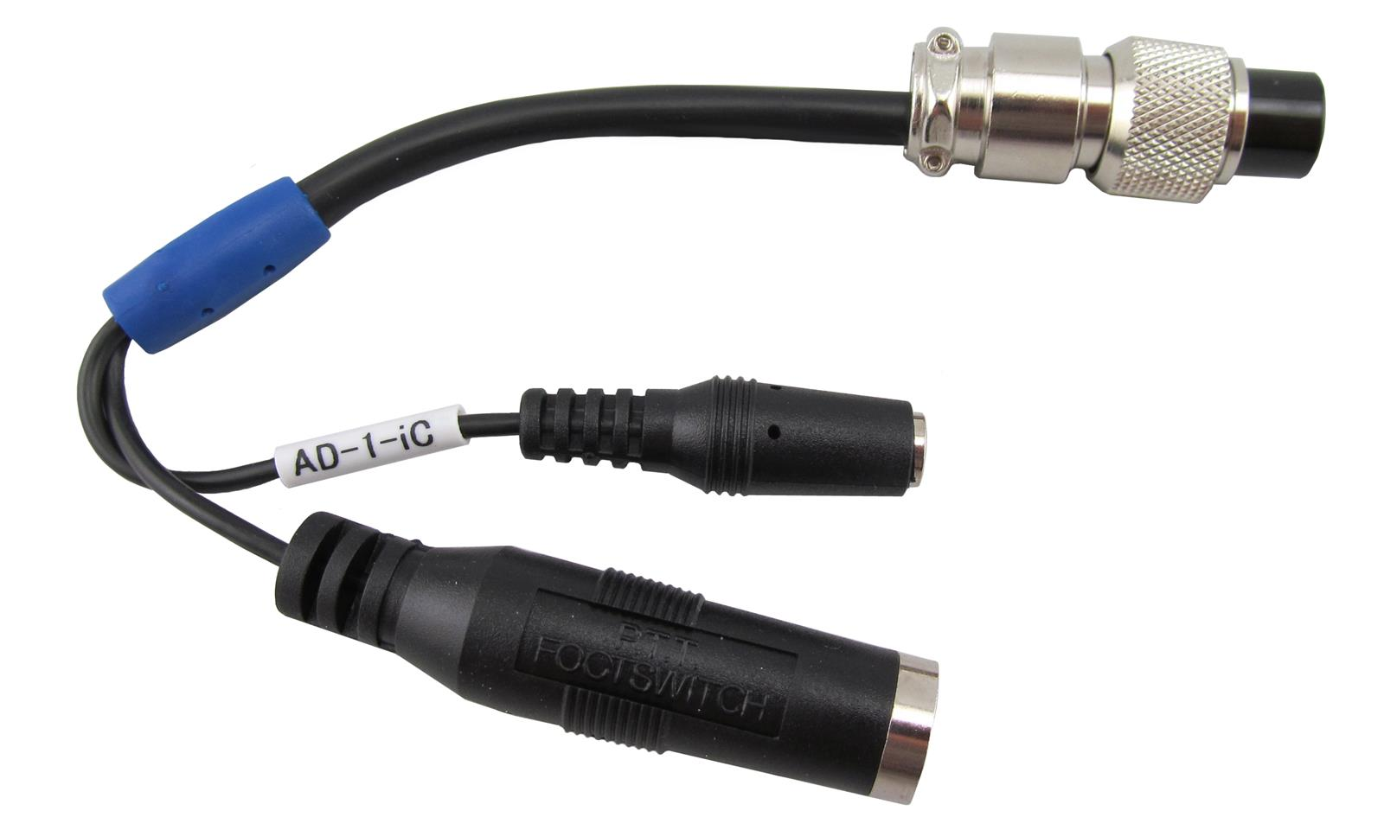
https://ohis.org/
Bob still has me covered...
Heil AD-1-iC Adapter:
Heil Pro 7 Headset:
Icom IC-7300 Microphone pinout:
Video

Slide 33
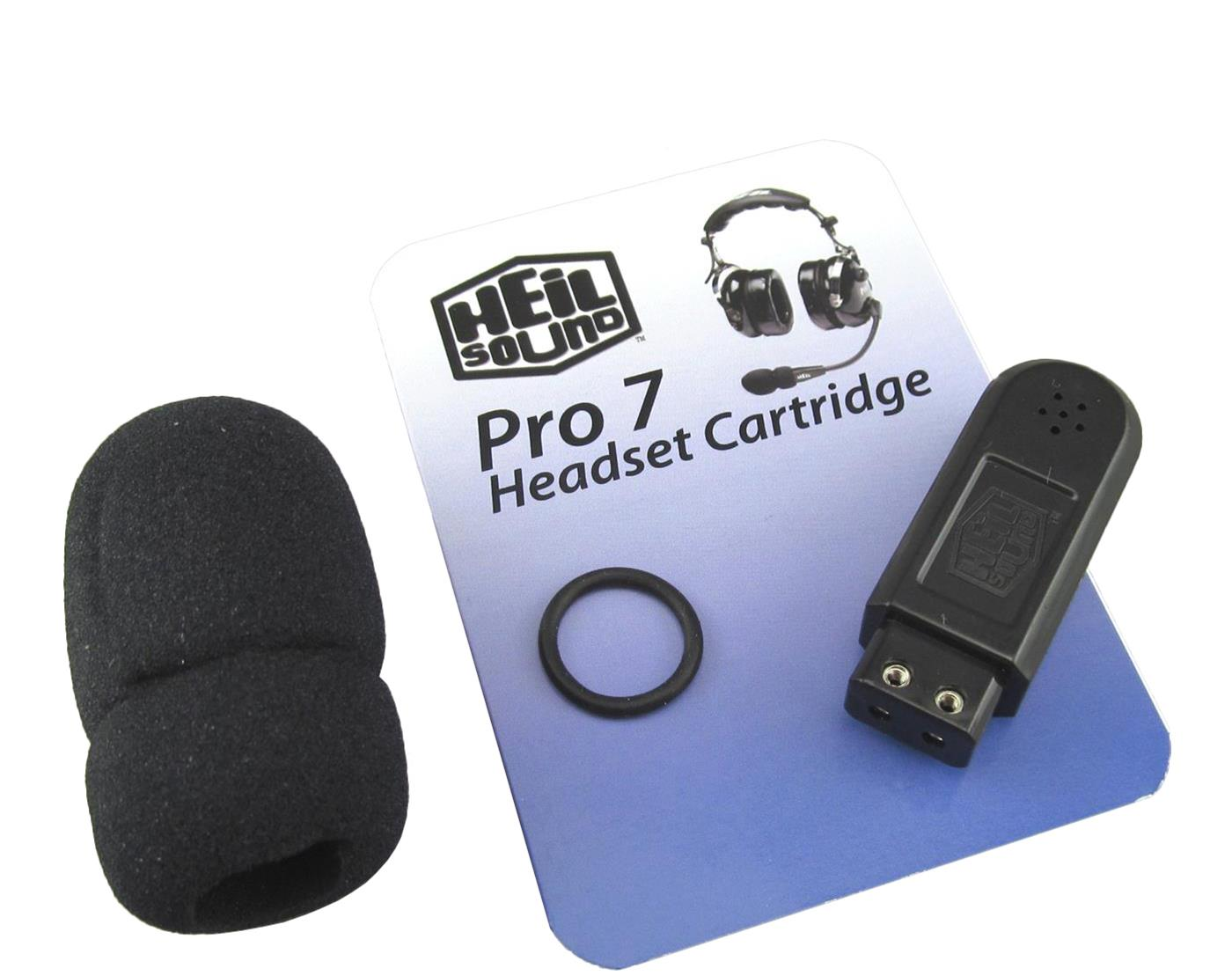
https://ohis.org/
But, wait a minute...
Heil AD-1-iC Adapter:
Heil Pro 7 Headset:
Icom IC-7300 Microphone pinout:
Heil P7-IC-ELEM Microphone Element:
Video

Slide 34
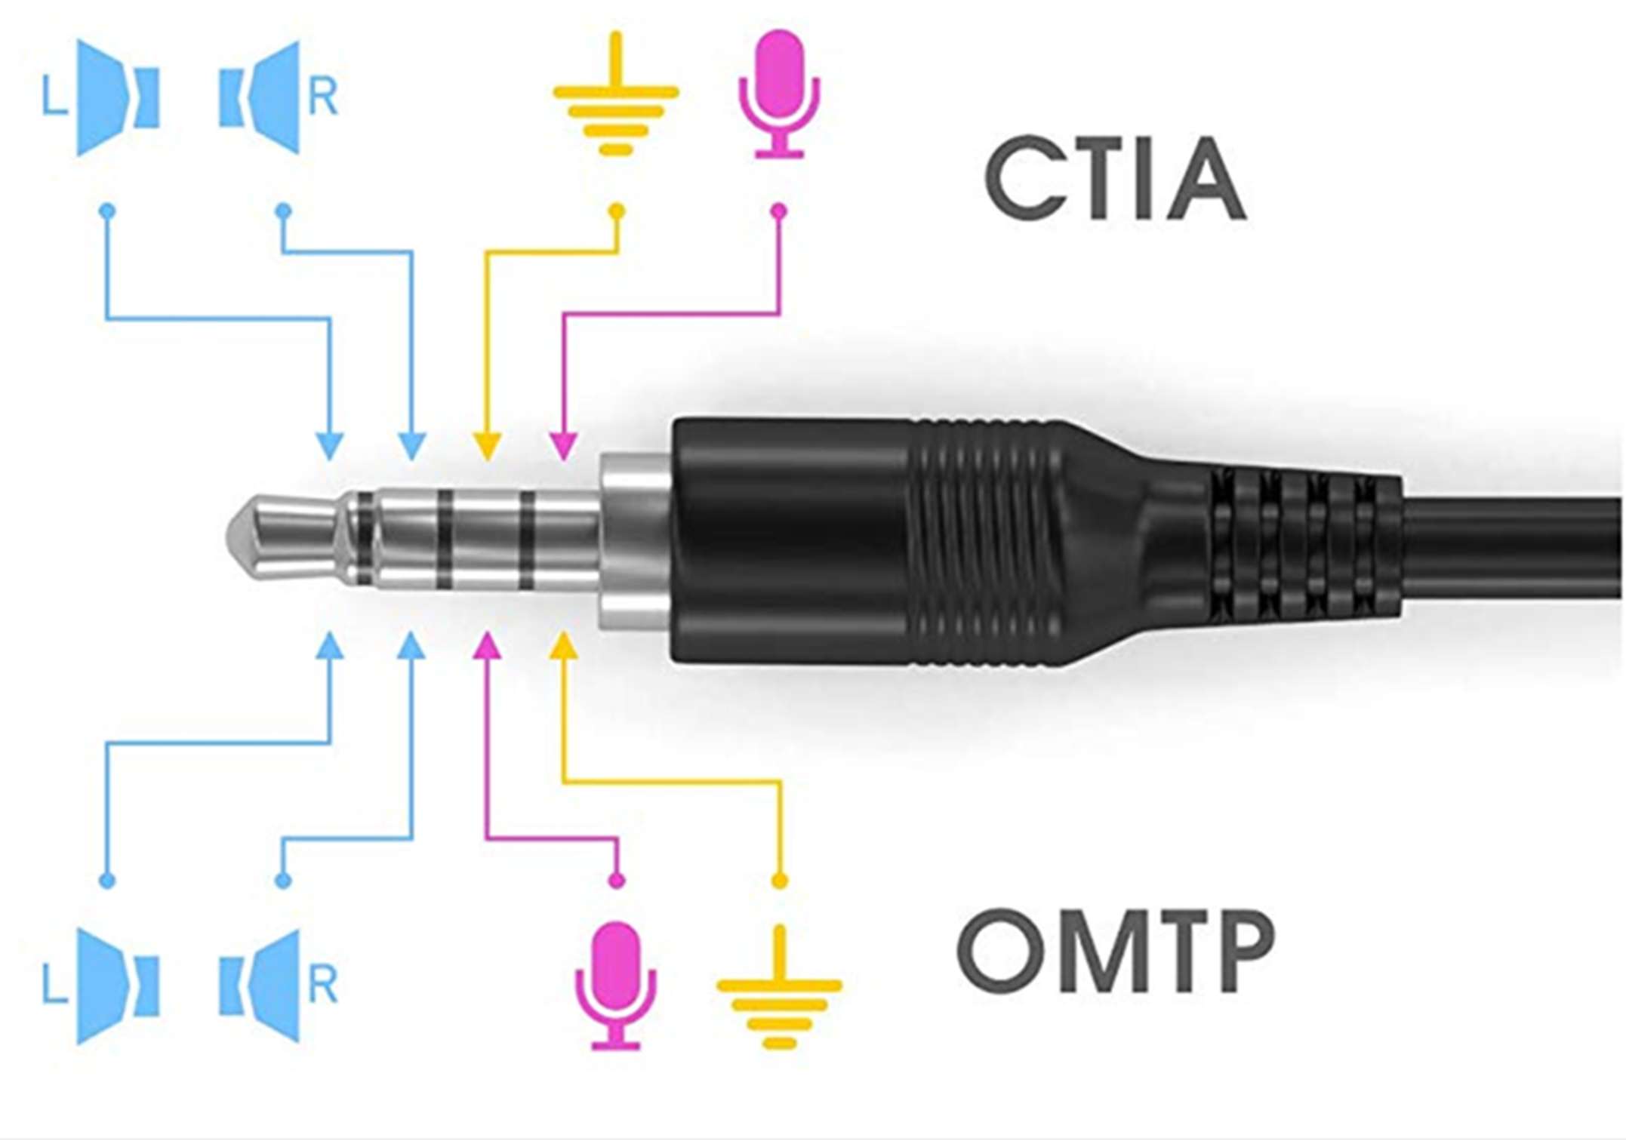
https://ohis.org/
Another headset,
CTIA “PC Gaming Headset”
or “Mobile Phone” pinout:
Yaesu FT-920 Microphone pinout:
Video

Slide 35
https://ohis.org/
Another headset, 3 more adapters...
CTIA “PC Gaming Headset”
or “Mobile Phone” pinout:
Yaesu FT-920 Microphone pinout:
Kenwood TS-890S Microphone pinout:
Icom IC-7300 Microphone pinout:
Video

Slide 36
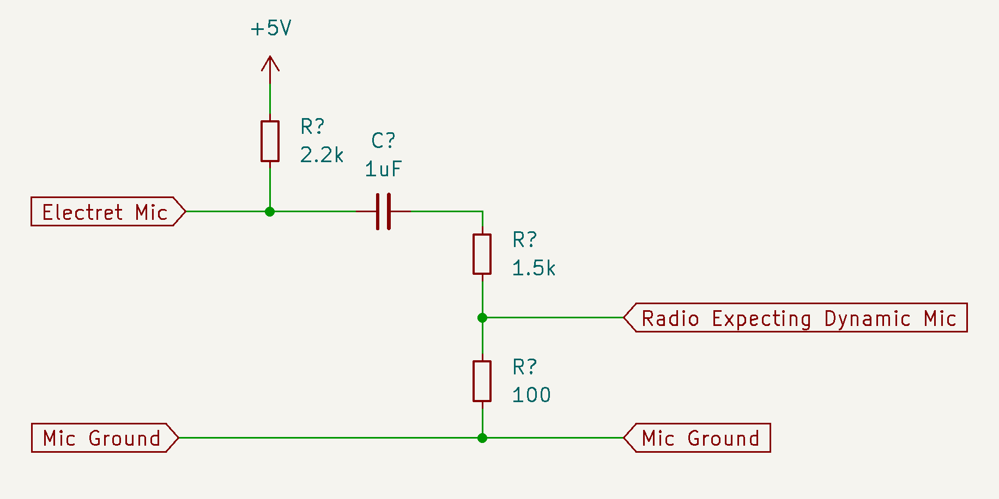
https://ohis.org/
“Your audio is distorted!”
CTIA “PC Gaming Headset”
or “Mobile Phone” pinout:
Yaesu FT-920 Microphone pinout:
Video

Slide 37
https://ohis.org/
Which 3.5mm TRRS was that?
CTIA “PC Gaming Headset”
or “Mobile Phone” pinout:
Video

Slide 38
https://ohis.org/
Which 3.5mm TRRS was that?
CTIA “PC Gaming Headset”
or “Mobile Phone” pinout:
Video

Slide 39
https://ohis.org/
Your Adapter Game is strong.
This is quickly getting out of hand.
It’s a full mesh of adapters, from every different headset to every different radio.
Video

Slide 40
https://ohis.org/
Your Adapter Game is strong.
This is quickly getting out of hand.
It’s a full mesh of adapters, from every different headset to every different radio.
How do we address this?
Video

Slide 41
https://ohis.org/
Your Adapter Game is strong.
This is quickly getting out of hand.
It’s a full mesh of adapters, from every different headset to every different radio.
How do we address this?
Video

Slide 42
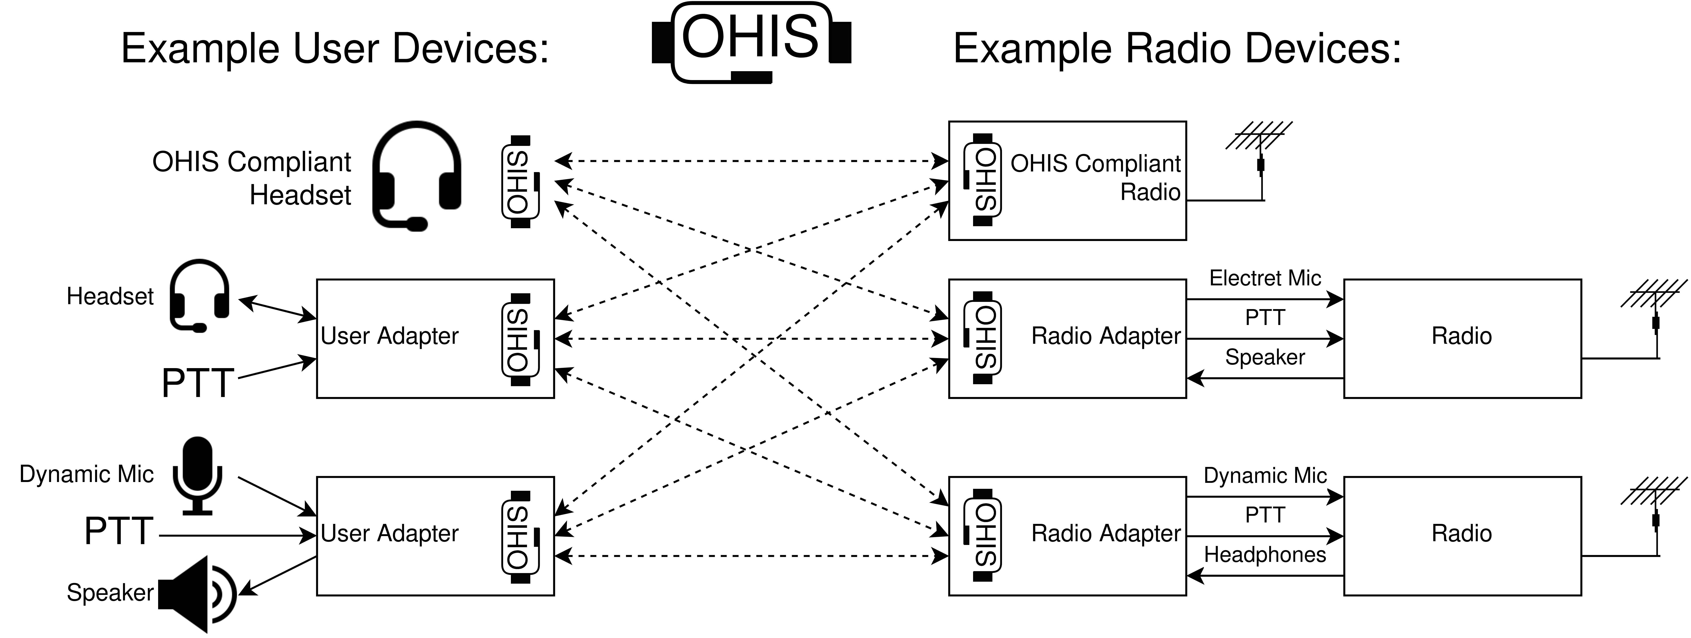
https://ohis.org/
Open Headset Interconnect Standard
Video

Slide 43
https://ohis.org/
Open Headset Interconnect Standard
User Device/Adapter: Specific to the headset, stays with the headset.
Video

Slide 44
https://ohis.org/
Open Headset Interconnect Standard
User Device/Adapter: Specific to the headset, stays with the headset.
Radio Device/Adapter: Specific to the radio, stays with the radio.
Video

Slide 45
https://ohis.org/
Open Headset Interconnect Standard
User Device/Adapter: Specific to the headset, stays with the headset.
Radio Device/Adapter: Specific to the radio, stays with the radio.
Open Headset Interconnect Standard is the connection between them.
Video

Slide 46
https://ohis.org/
Technical Summary
Electrical:
Video

Slide 47
https://ohis.org/
Technical Summary
Electrical:
Microphone: “Electret” level: -45dBV +/- 3dB, pseudo-balanced. +5vDC bias provided by Radio Device.
Video

Slide 48
https://ohis.org/
Technical Summary
Electrical:
Microphone: “Electret” level: -45dBV +/- 3dB, pseudo-balanced. +5vDC bias provided by Radio Device.
Audio Out: “Headphone” level: 0dBV full volume, ground referenced, stereo.
Video

Slide 49
https://ohis.org/
Technical Summary
Electrical:
Microphone: “Electret” level: -45dBV +/- 3dB, pseudo-balanced. +5vDC bias provided by Radio Device.
Audio Out: “Headphone” level: 0dBV full volume, ground referenced, stereo.
PTT: Contact closure to power ground.
Video

Slide 50
https://ohis.org/
Technical Summary
Electrical:
Microphone: “Electret” level: -45dBV +/- 3dB, pseudo-balanced. +5vDC bias provided by Radio Device.
Audio Out: “Headphone” level: 0dBV full volume, ground referenced, stereo.
PTT: Contact closure to power ground.
Power: (Optional) +5vDC 200mA provided by Radio for audio amplifiers, LED indicators, signal processing, etc.
Video

Slide 51
https://ohis.org/
Technical Summary
Physical:
Video

Slide 52
https://ohis.org/
Technical Summary
Physical:
Connector: 8P8C Modular. (Commonly, but incorrectly, known as RJ-45.)
Video

Slide 53
https://ohis.org/
Technical Summary
Physical:
Connector: 8P8C Modular. (Commonly, but incorrectly, known as RJ-45.)
Cable: Shielded Cat5 (or better).
Video

Slide 54
https://ohis.org/
Technical Summary
Physical:
Connector: 8P8C Modular. (Commonly, but incorrectly, known as RJ-45.)
Cable: Shielded Cat5 (or better).
Wiring: TIA-568A or 568B. Which pins are pairs is important.
Video

Slide 55
https://ohis.org/
Technical Summary
Physical:
Connector: 8P8C Modular. (Commonly, but incorrectly, known as RJ-45.)
Cable: Shielded Cat5 (or better).
Wiring: TIA-568A or 568B. Which pins are pairs is important.
Allows the use of common off-the-shelf Ethernet cables.
Video

Slide 56
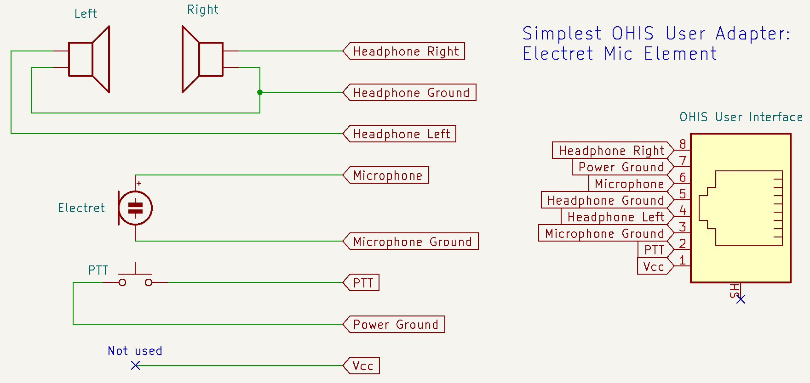
https://ohis.org/
Technical Summary
Pin-out:
Video

Slide 57
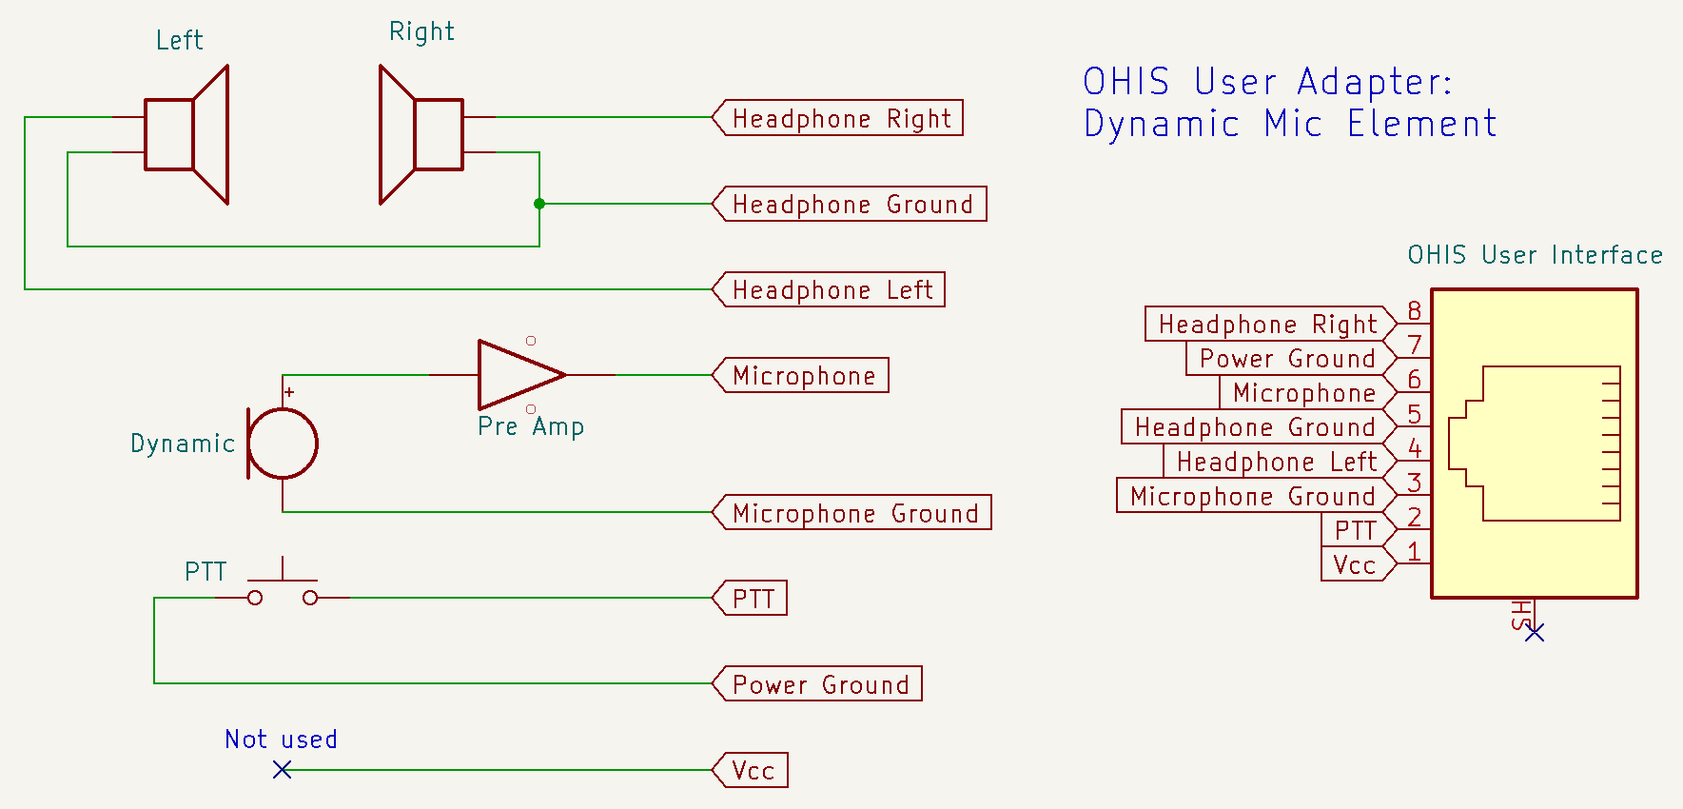
https://ohis.org/
Technical Summary
Pin-out:
Video

Slide 58
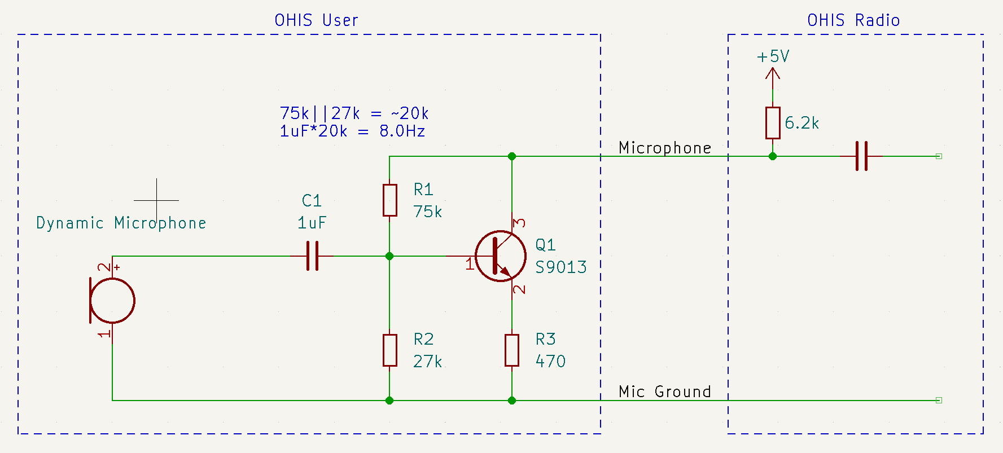
https://ohis.org/
Dynamic Mic Pre-Amp
Part of the open standard, freely available for use.
Video

Slide 59
https://ohis.org/
When is OHIS useful?
Video

Slide 60
https://ohis.org/
When is OHIS useful?
When you have several different radios and headsets.
Video

Slide 61
https://ohis.org/
When is OHIS useful?
When you have several different radios and headsets.
When you operate in a multi-user environment and users have their own (different) headsets.
Video

Slide 62
https://ohis.org/
When is OHIS useful?
When you have several different radios and headsets.
When you operate in a multi-user environment and users have their own (different) headsets.
  Examples: Field Day, club shack, or an Emergency Operations Center.
Video

Slide 63
https://ohis.org/
When is OHIS useful?
When you have several different radios and headsets.
When you operate in a multi-user environment and users have their own (different) headsets.
  Examples: Field Day, club shack, or an Emergency Operations Center.
To present a common electrical interface for devices between the user and the radio.
Video

Slide 64
https://ohis.org/
When is OHIS over-kill?
Video

Slide 65
https://ohis.org/
When is OHIS over-kill?
When you only have one radio, or one headset, or any situation where the “full mesh” problem doesn’t apply.
Video

Slide 66
https://ohis.org/
When is OHIS over-kill?
When you only have one radio, or one headset, or any situation where the “full mesh” problem doesn’t apply.
When you already have all the adapters you need.
Video

Slide 67
https://ohis.org/
When is OHIS over-kill?
When you only have one radio, or one headset, or any situation where the “full mesh” problem doesn’t apply.
When you already have all the adapters you need.
When you prefer the simplicity of a single adapter between you and your radio.
Video

Slide 68
https://ohis.org/
Why an Open Standard?
Video

Slide 69
https://ohis.org/
Why an Open Standard?
Open is how we get out of this mess.
Video

Slide 70
https://ohis.org/
Why an Open Standard?
Open is how we get out of this mess.
It makes a good DIY project.
Video

Slide 71

https://ohis.org/
Learn more:
https://ohis.org/
Video

Slide 72
Questions and Answers
Beginning now

Slide 73
Slide Title
Slide Content
Video

